Slide 1
Levi9 CODE9 2022
Unit Testing in C#
Marko Tatić, Saša Grahovac
Novi Sad, 21.05.2022.

Slide 2
Agenda
01
04
About Us
Tips, Tricks and Links
02
05
What is Unit Testing
A More Practical Approach
03
06
Fundamentals
Questions

Slide 3
01. About US
Marko Tatić
Junior .Net developer
Fellow FTN student (Uskoro pa ulazi u kategoriju večitog studenta :D )
Filmophile, Gamer, Traveler
Grahovac Saša
Medior .Net developer
More than 5 years experience in Mobile and Web in C#, over various domains
Gaming nerd

Slide 4
02. What is unit testing?
Unit - refers to the smallest testable part of a software application
Code testing, in code
Why is this developer’s job
Why is it important
Testing code is still code (maintainability, flexibility, cleanness)
Unit tests vs integration tests
TDD
What is TDD?
Test Driven Development vs The Reality
Notes:
Reminder: failing tests either mean that the code updated/added if faulty, or that that the tests are outdated.

Slide 5
What is unit testing?
A “Unit” in Unit Testing
Building a proper SUT (system under test)
Triple A approach: Arrange-Act-Assert
Setup/Teardown – Constructor/Dispose
Mocking data
What (not) to test in unit tests?
NuGets packages
xUnit, nUnit, MSTest
Moq, NSubstitute
FluentAssert
AutoFixture
Coverage tools

Slide 6
03. Fundamentals
Setting up your project
App and app tests should be in separate projects.
Starting off
“Happy flows” vs edge-cases: How much is too much?
Unit tests should be: Fast/Isolated/Repeatable/Self-Checking/Timely
What to test – understand the ‘unit’ you are testing
Naming conventions
What do failed unit tests mean?

Slide 7
04. Tips, tricks and links
Make your life easier
Plan unit tests into your development process (tickets - story points)
Take conventions and documentation into account
Remove deprecated code
Debugging
Prepare data and yourself
Setup data in bulk and reuse it
Tests in general can and will show you overlooked areas in your code

Slide 8
05. A more practical approach
Simple example
Possible approaches
Why interfaces
Naming and fluent assertions
Working with a live project
Get the project from the git repo: TODO
Rebuild and start the project
Investigate the given test
Add more tests

Slide 9
links
Useful links:
Best practices for writing unit tests - .NET | Microsoft Docs
Unit testing C# code in .NET Core using dotnet test and xUnit - .NET | Microsoft Docs
Organizing and testing projects with the .NET CLI - .NET | Microsoft Docs
Home > xUnit.net
Moq - Moq Documentation
Fluent Assertions
AutoFixture

Slide 10
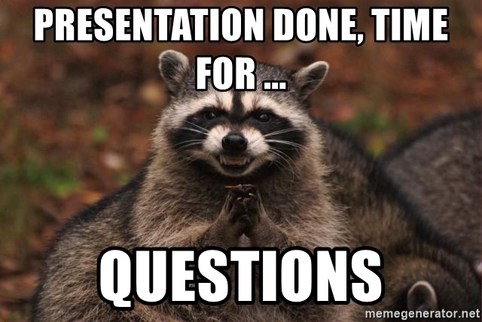
06. questions?
Notes:
FAQs? Maybe?

Slide 11
Thank you
Serbia / Novi sad
Levi9 Global Sourcing Balkan d.o.o.
Novi Sad Offices
Trifkovicev trg 6
21000 Novi Sad, Serbia

